Slide 1
Welcome!!!
Hello!
Hi!

Slide 2

Raduan Ahamad
191-15-12943
O14
CSE
Daffodil International University

Slide 3
Comparative Study on Different Algorithms

Slide 4
Why Algorithms??

Slide 5
Algorithm ?
An algorithm is a step by step procedure to solve logical and mathematical problems. A recipe is a good example of an algorithm because it says what must be done, step by step. ... In computing, an algorithm is a precise list of operations that could be done by a Turing machine.

Slide 6
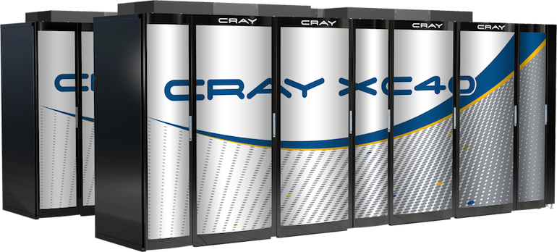

Microsoft Cray
Super Computer Than You Can Take on Rent From Google

Slide 7
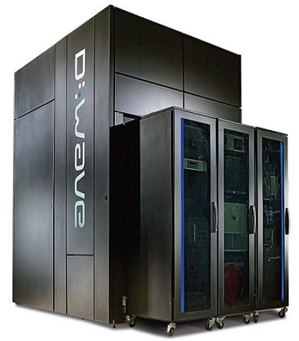
D Wave
Google’s Quantum Computer
100 Million Times Faster Than Pc
But Can’t Run Games !!!

Slide 8

Computer A
Computer B
Lets assume
computer A executes
10 Billion instructions per seconds
Lets assume
computer B executes
10 Million instructions per seconds

Slide 9
2. (10^7) ² instructions = 20,000 seconds (more than 5.5 hours) 10^10 instruction/second
Computer A takes
While Computer B takes
50. 10^7 lg 10^7 instructions = 1163 seconds (less than 20 minutes) 10^7 instruction/second

Slide 10
Despite
Hardware Facts
Data
Algorithms

Slide 11

Concept Behind
Searching Algorithms

Slide 12
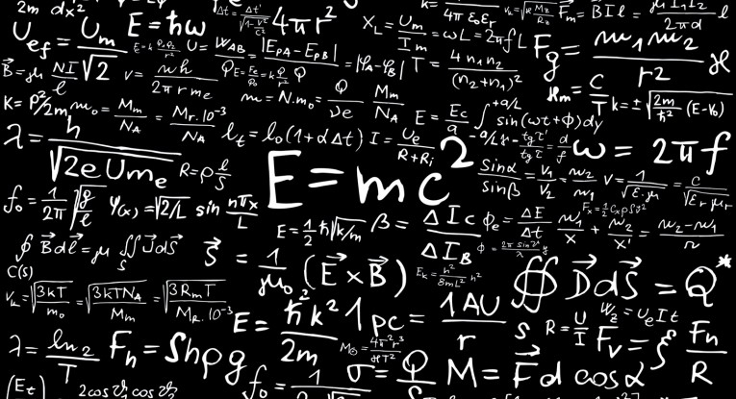

Faraz Ahmed ​
ID: 191-15-12948​
CSE​
Daffodil International University​

Slide 13
What is LCS( longest common subsequence)
LCS using recursion
LCS using dynamic programing (Tabulation bottom up method)

Slide 14
What is LCS( longest common subsequence )

Slide 15
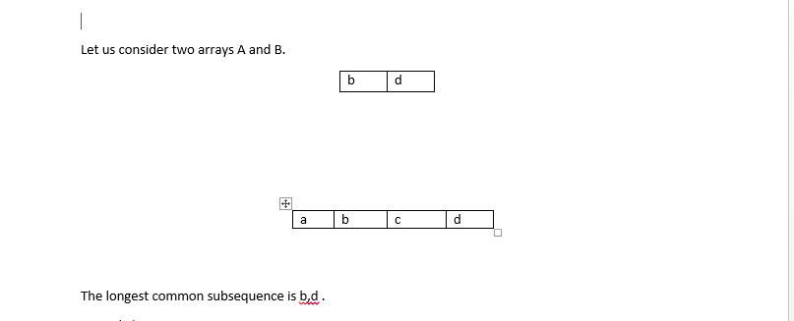


Slide 16
LCS using recursion

Slide 17
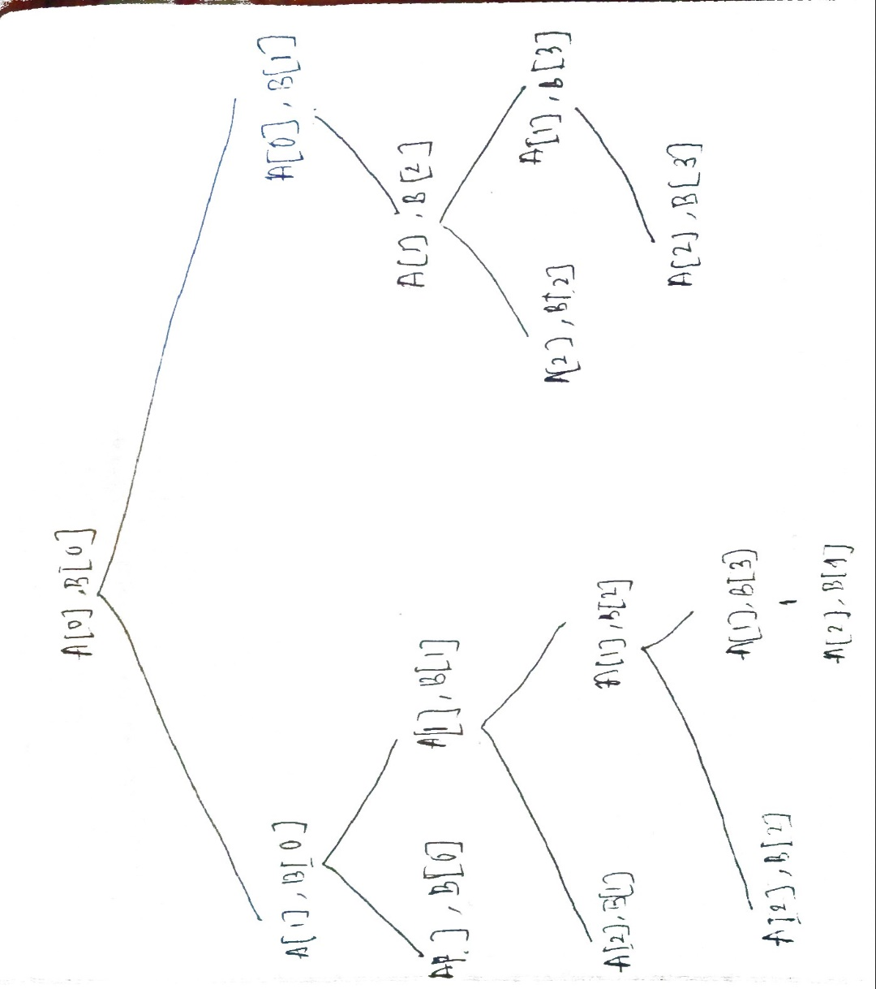
The longest common subsequence is b,d .
int Lcs(i,j)
{
if (A[i]== '/0' || B[j] == '/0')
return 0;
else if(A[i] == B[j])
return 1=Lcs(i+1,j+1)
else
return max(Lcs(i+1,j), Lcs(i,j+1));
}

Slide 18
LCS with tabulation method ( Bottom Up)

Slide 19
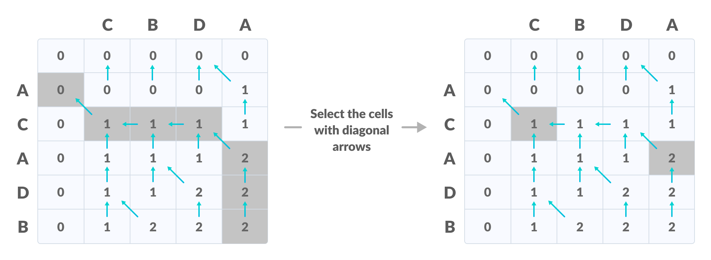

Slide 20
void lcs(char *S1, char *S2, int m, int n) {
int LCS_table[m + 1][n + 1];
// Building the mtrix in bottom-up way
for (int i = 0; i <= m; i++) {
for (int j = 0; j <= n; j++) {
if (i == 0 || j == 0)
LCS_table[i][j] = 0;
else if (S1[i - 1] == S2[j - 1])
LCS_table[i][j] = LCS_table[i - 1][j - 1] + 1;
else
LCS_table[i][j] = max(LCS_table[i - 1][j], LCS_table[i][j - 1]);
}

Slide 21

M Shahriar Ishtiaque
ID: 191-15-12938
CSE
Daffodil International University

Slide 22
What is Sorting?
Sorting is a process of arranging a set of data or numbers in a Ascending Order or Descending Order.
Example:
Sort the numbers given below in Descending order
10, 30,20,50,60,40,100
Sorted: 100,60,50,40,30,20,10

Slide 23
Sorting is done by various algorithms to manage the time complexity of problems.
There are various kind of sorting algorithms.
Like –
Bubble Sort.
Recursive Bubble Sort.
Insertion Sort.
Recursive Insertion Sort.
Merge Sort.
Iterative Merge Sort.
Quick Sort

Slide 24
Now I will be discussing about :
Insertion Sort.
Merge Sort.
Quick Sort.

Slide 25
INSERTION SORT
One element from the input elements is consumed in each iteration to find it’s correct position, the position to which it belongs in sorted array.
If the current element is greater than the elements of it’s left side than leave it. Else, shift all the elements which is larger than the current elements.

Slide 26
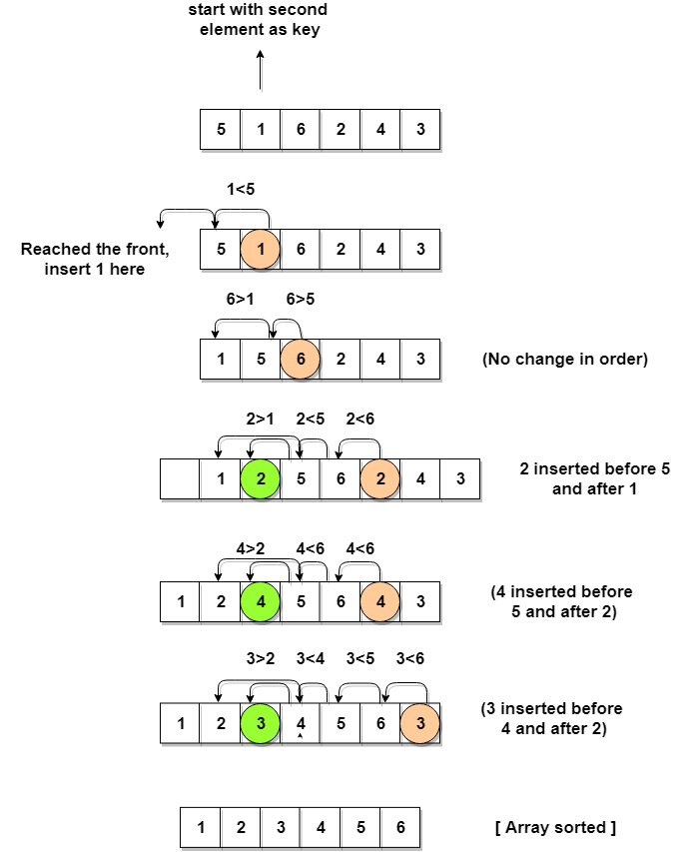
Worst complexity: n^2 Average complexity: n^2 Best complexity: n Space complexity: 1
Time Complexity:

Slide 27
Merge Sort
Merge sort is a sorting technique based on divide and conquer technique. Merge sort first divides the array into equal halves and then combines them in a sorted manner.

Slide 28
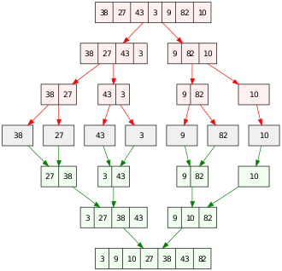
Merge Sort Example:
Worst complexity: n*log(n)
Average complexity: n*log(n)
Best complexity: n*log(n)
Time Complexity

Slide 29
Quick Sort
Quicksort is a divide-and-conquer algorithm. It works by selecting a 'pivot' element from the array and partitioning the other elements into two sub-arrays, according to whether they are less than or greater than the pivot. The sub-arrays are then sorted recursively.

Slide 30
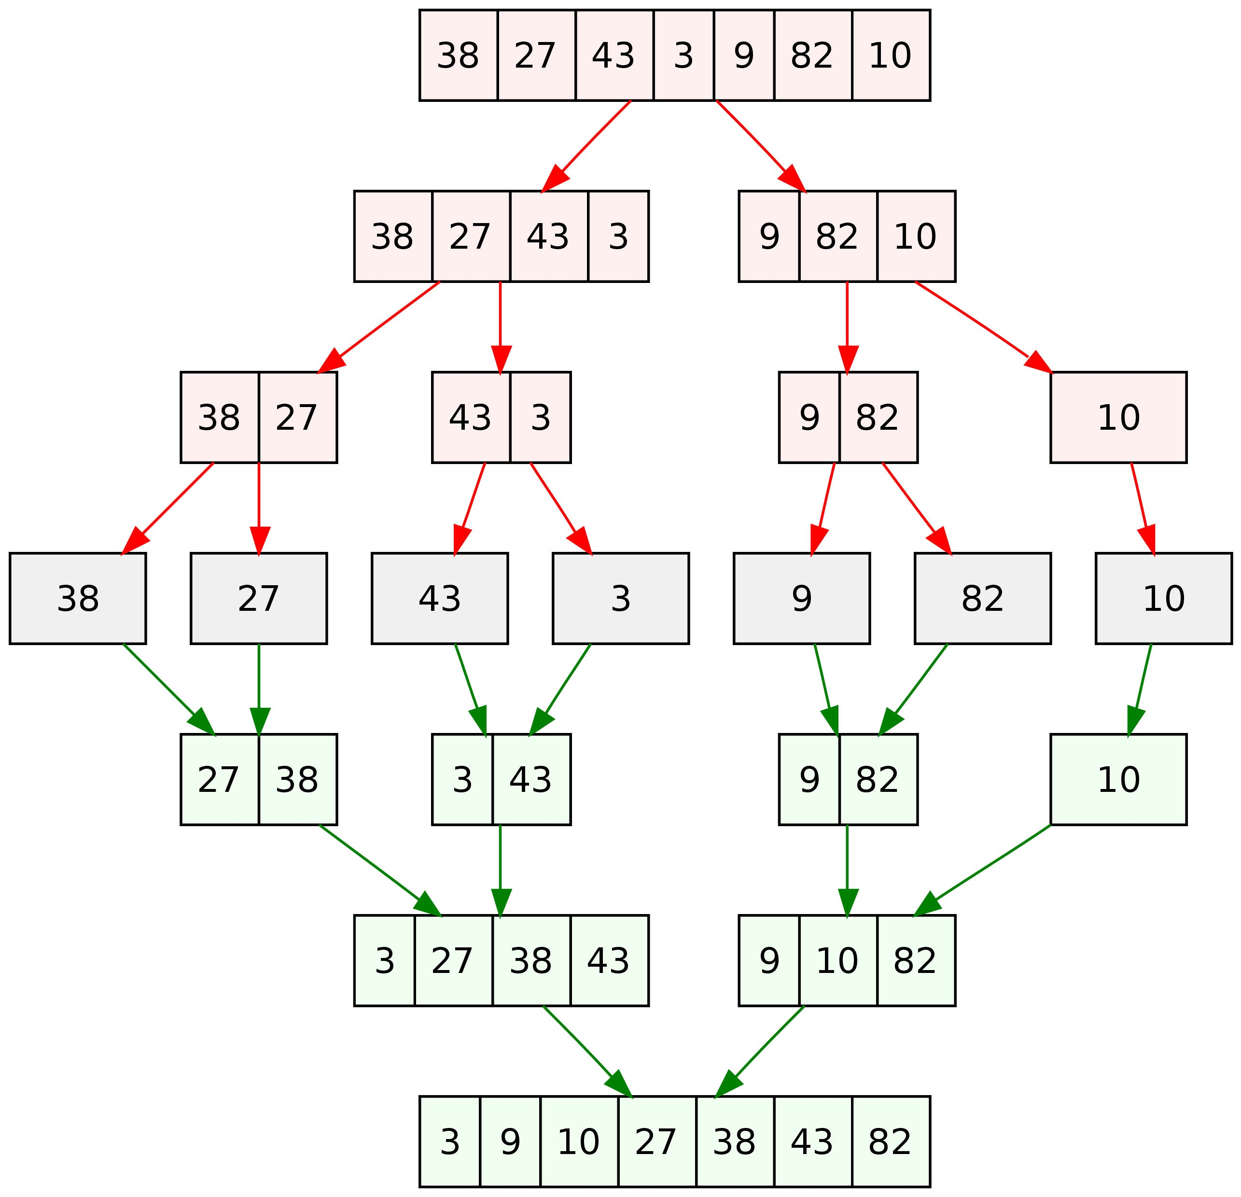
Quick Sort example:
Time complexity
Worst case complexity: n^2
Average case complexity: n*log(n)
Best case complexity: n*log(n)

Slide 31
Difference between Quick Sort and Insertion Sort:
BASIS FOR COMPARISON | QUICK SORT | INSERTION SORT
Efficiency | More efficient | Less efficient
Speed | Faster | Slower
Worst case complexity | O(n^2) | n^2
Best case complexity | n*log(n) | n

Slide 32
Difference between Quick Sort and Merge Sort:
BASIS FOR COMPARISON | QUICK SORT | MERGE SORT
Partitioning of the elements in the array | The splitting of a list of elements is not necessarily divided into half. | Array is always divided into half (n/2).
Worst case complexity | O(n²) | O(n log n)
Works well on | Smaller array | Operates fine in any type of array.
Speed | Faster than other sorting algorithms for small data set. | Consistent speed in all type of data sets.
Additional storage space requirement | Less | More
Efficiency | Inefficient for larger arrays. | More efficient.
Sorting method | Internal | External

Slide 33

Sakib Rokoni
ID : 191-15-12961
Section : O14
Department Of CSE ,
Daffodil International University .

Slide 34
Longest common subsequence using memorization (Top Down)
int lcs (string X, string Y, int m, int n, int
dp[][maximum])
{
// base case
if (m == 0 || n == 0)
return 0;
// if the same state has already been
// computed
if (dp[m - 1][n - 1] != -1)
return dp[m - 1][n - 1];
// if equal, then we store the value of the
// function call
if (X[m - 1] == Y[n - 1]) {
// store it in arr to avoid further repetitive
// work in future function calls
dp[m - 1][n - 1] = 1 + lcs(X, Y, m - 1, n - 1, dp);
return dp[m - 1][n - 1];
}
else {
// store it in arr to avoid further repetitive
// work in future function calls
dp[m - 1][n - 1] = max(lcs(X, Y, m, n - 1, dp),
lcs(X, Y, m - 1, n, dp));
return dp[m - 1][n - 1];
}
}

Slide 35
char lcs[index + 1];
lc[index] = '\0';
int i = m, j = n;
while (i > 0 && j > 0) {
if (S1[i - 1] == S2[j - 1]) {
lcs[index - 1] = S1[i - 1];
i--;
j--;
index--;
}
else if (LCS_table[i - 1][j] > LCS_table[i][j - 1])
i--;
else
j--;
}

Slide 36
Use a 2-D array to store the computed lcs(m, n) value at arr[m-1][n-1] because the string index starts from 0. Whenever the function with an equivalent argument m and n are called again, don't perform any longer recursive call and return arr[m-1][n-1] because the previous computation of the lcs(m, n) has already been stored in arr[m-1][n-1], hence reducing the recursive calls that happen more than once.
Time Complexity: O(M*N), where M and N is length of the first and second string respectively.
Auxiliary Space: (M*N)

Slide 37
Thanks!!!

